Slide 1
Institute of Technology of Cambodia Class Level : Third Year I3 Department of Applies Mathematics and Statistics Subject : Object Oriented Programming Topic : The Best Route in Cambodia Project Proposal Group : Find shortest routes with map Professor : Mr. Tal Tongsreng (Course) Dr. Chan Sophal (TP) Academic Year : 2022-2023

Slide 2
Members of Group 04
Kry Senghort
Lim Sunheng
Buth Cheableng
Ek Vong
Panharith
Koythol Amrint

Slide 3
General Introduction
1
Objective
2
Processing flowchart of Project
Content
3
Materials of Project
4
Schedule of Group Work
5
Summarize and Conclusion
6

Slide 4
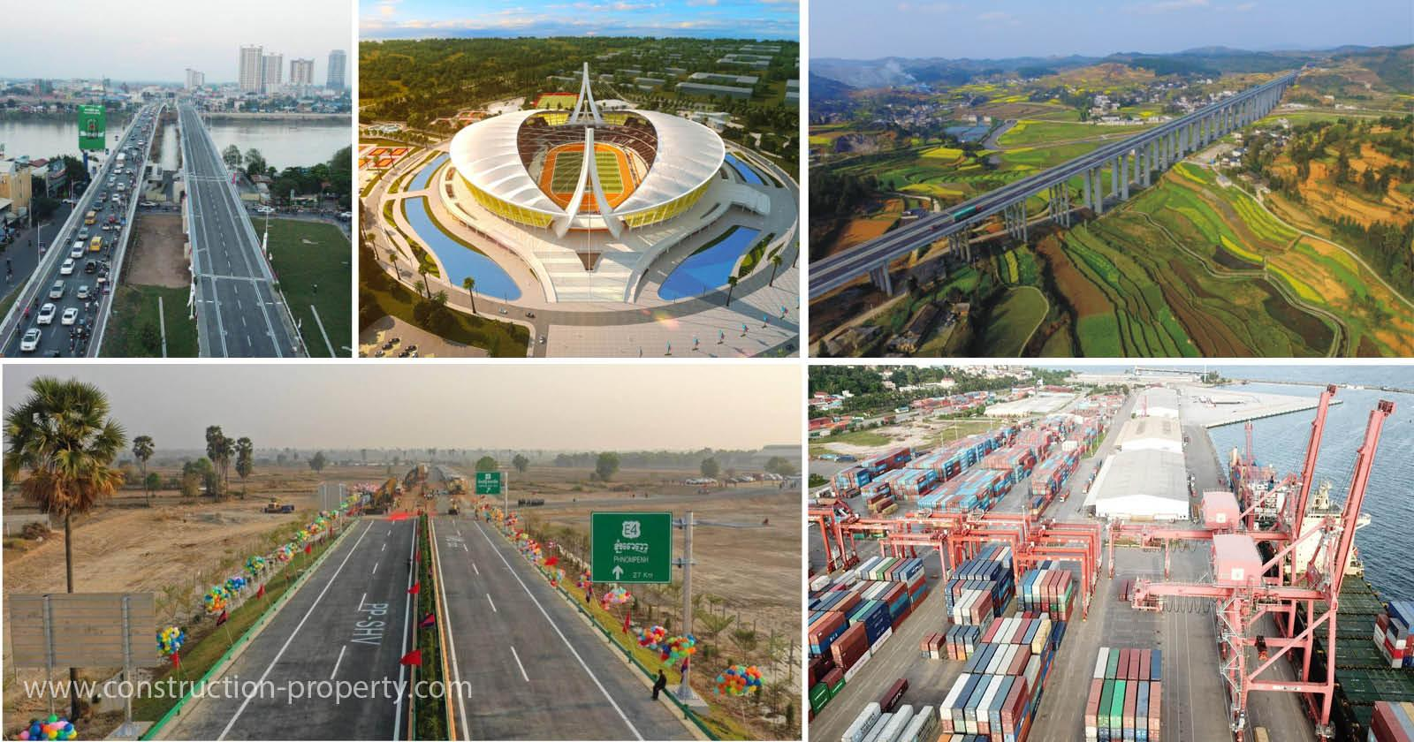
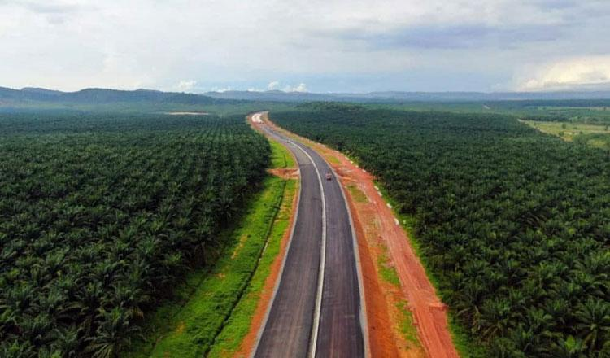
Cambodia is a developing country where there are lots of infrastructure(routes, bridges, buildings) are manufacturing. Ministry of Public Work and Transportation have repaired and create more route that connected from Phnom Penh to another provinces
and from
province
to province.
General Introduction
1

Slide 5
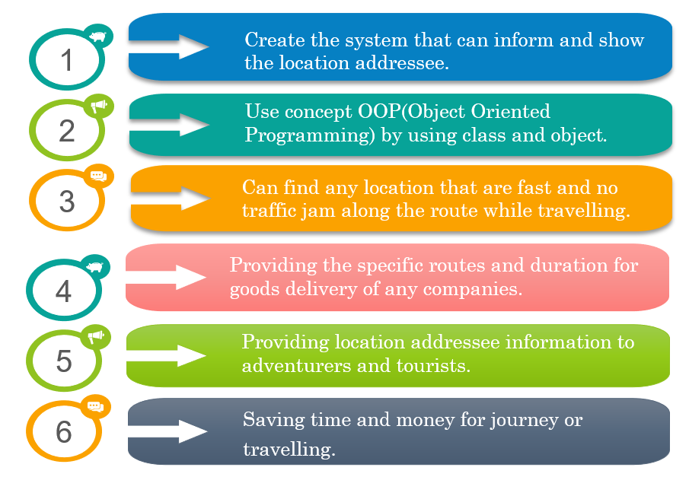
Objective
2

Slide 6
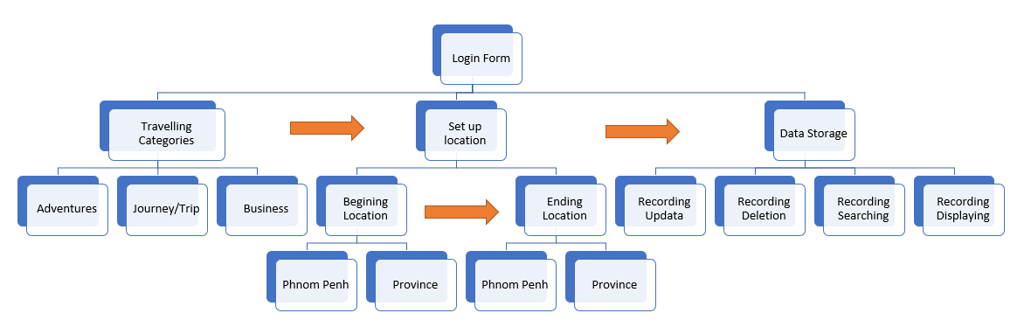
Processing flow​ chart of Project
3

Slide 7
There are some materials that use in our project such as:
Concept class and object
Abstraction & Inheritance concept
Polymorphism & Encapsulation concept
Modifier concept
Database SQL
API(Application Programming Interface)
Graph Algorithm theory
Short path algorithm: Dijkstra algorithm
Google map connection and python use as auxiliary language
Materials of Project
4

Slide 8
Schedule of Group Work
5
STEP 1
STEP 2
STEP 3
STEP 4
Data Collection
Data Analysis
Coding Implementation
Data Summarization
After summarize data we will create the algorithm to represent data by using the material above. Especially using concept OOP(Object Oriented Programming).
Start from 30th December until 27th january
This step we will analyze data and consider which points are the extra that we can cut it out. We just focus on the main sample that deduce from population of data collection.
Start from 14th December until 24th December
For the first step we need to find and go to visit the all of route in the provinces and the next is Phnom Penh.
Start from 14th November until 14th December.
After Data Analysis, we can summarize data with classification by types. Data will be organized as group.
Start from 24th December until 30th December

Slide 9
Since according to the above expression we can assume that :
This project need to spend time for 16 weeks
The main objective is to make easy and reducing time on journey.
Concept OOP is supported by this project.
The some business use google map too much for searching route in Cambodia.
Summary and Conclusion
6

